Slide 1
i-Ready Completion
Exit Ticket: Completion Verified

Slide 2
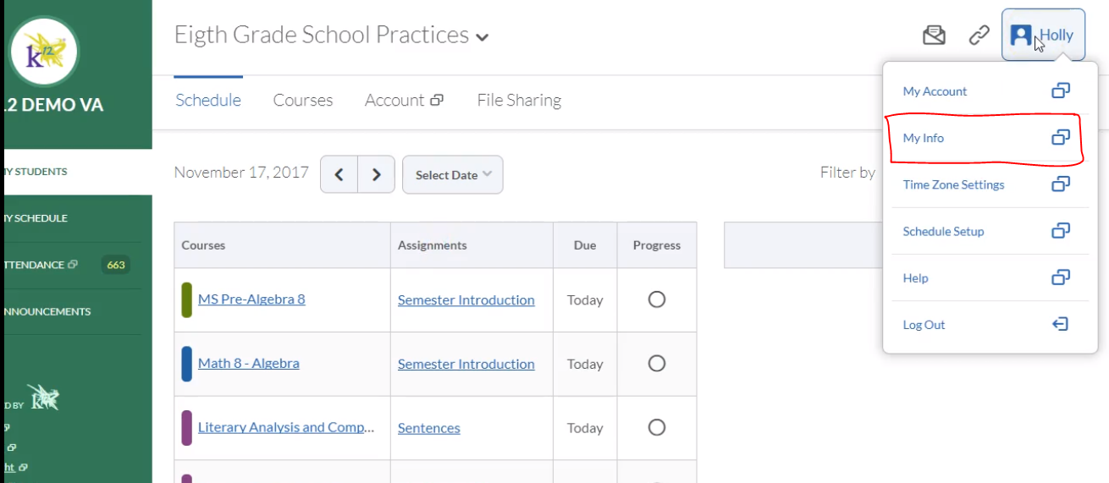
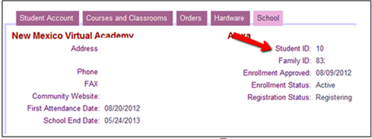
Student ID
1
To find your student’s ID if you don’t know it:
From the LC’s account, click on your name in the top right hand corner.
Click on My Info
Click on student name in new window
Click on School tab
Student ID is on the right
2
3
4
Notes:
https://login.i-ready.com/
Tell families that you are going to walk them through the process. Then you will web push the link to iReady and they can get started during the session.
They will not complete the test during the session, they will start it. We will ask families to sign out after 20-25 minutes for the next grade level to log in

Slide 3
Important Note
Parents and Learning Coaches,
PLEASE DO NOT HELP with ANY PORTION of this assessment. Do not READ or COACH your child at all. This is not a learning opportunity for teaching, but an assessment opportunity to identify strengths and weaknesses.
Assistance will lead to inaccurate results and may require retesting.
If you would like to learn more about i-Ready, please use visit the family center: http://i-readycentral.com/familycenter/

Slide 4
Preparing for the i-Ready Diagnostic

Slide 5
We will soon be taking our i-Ready Diagnostic!
Are you ready to show off what you know?

Slide 6
The Diagnostic will help your teachers know what you’ve learned and what you still need to learn.
It will also help i-Ready know what lessons to give you that are “just right” for you.
Notes:
Put these in word bubble?

Slide 7
Some helpful reminders:
i-Ready is a test that adapts to you.
You will see questions that seem very simple and others that are more difficult until it finds questions that are “just right” for you.
You may get questions you have not learned yet.
If you rush, you may have to restart the test.

Slide 8
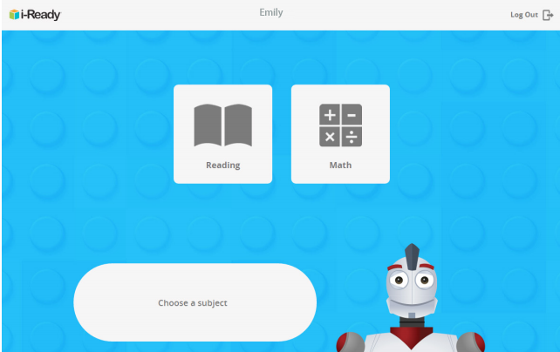
Once you log in, you will see this page:

Slide 9
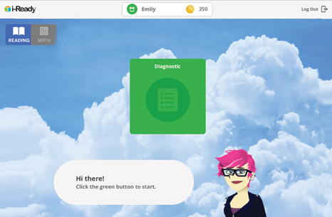
Next, you will see a page like this:

Slide 10
In Math, you may see questions that look like this:
Move your mouse to this speaker icon if you would like to hear the question again.
Clicking on the Done button submits your answer. You cannot change your answer after you click on this button.
Select an answer by clicking on it.
Click on the tool button if the question asks you to.

Slide 11
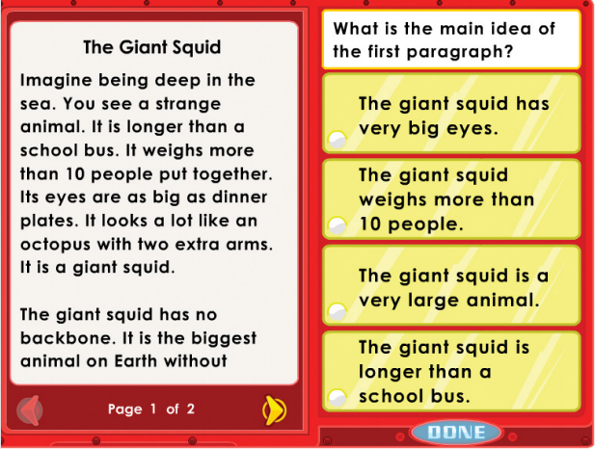
In Reading, you may see questions that look like this:
Use these arrows to go forward and backward within reading passages.

Slide 12
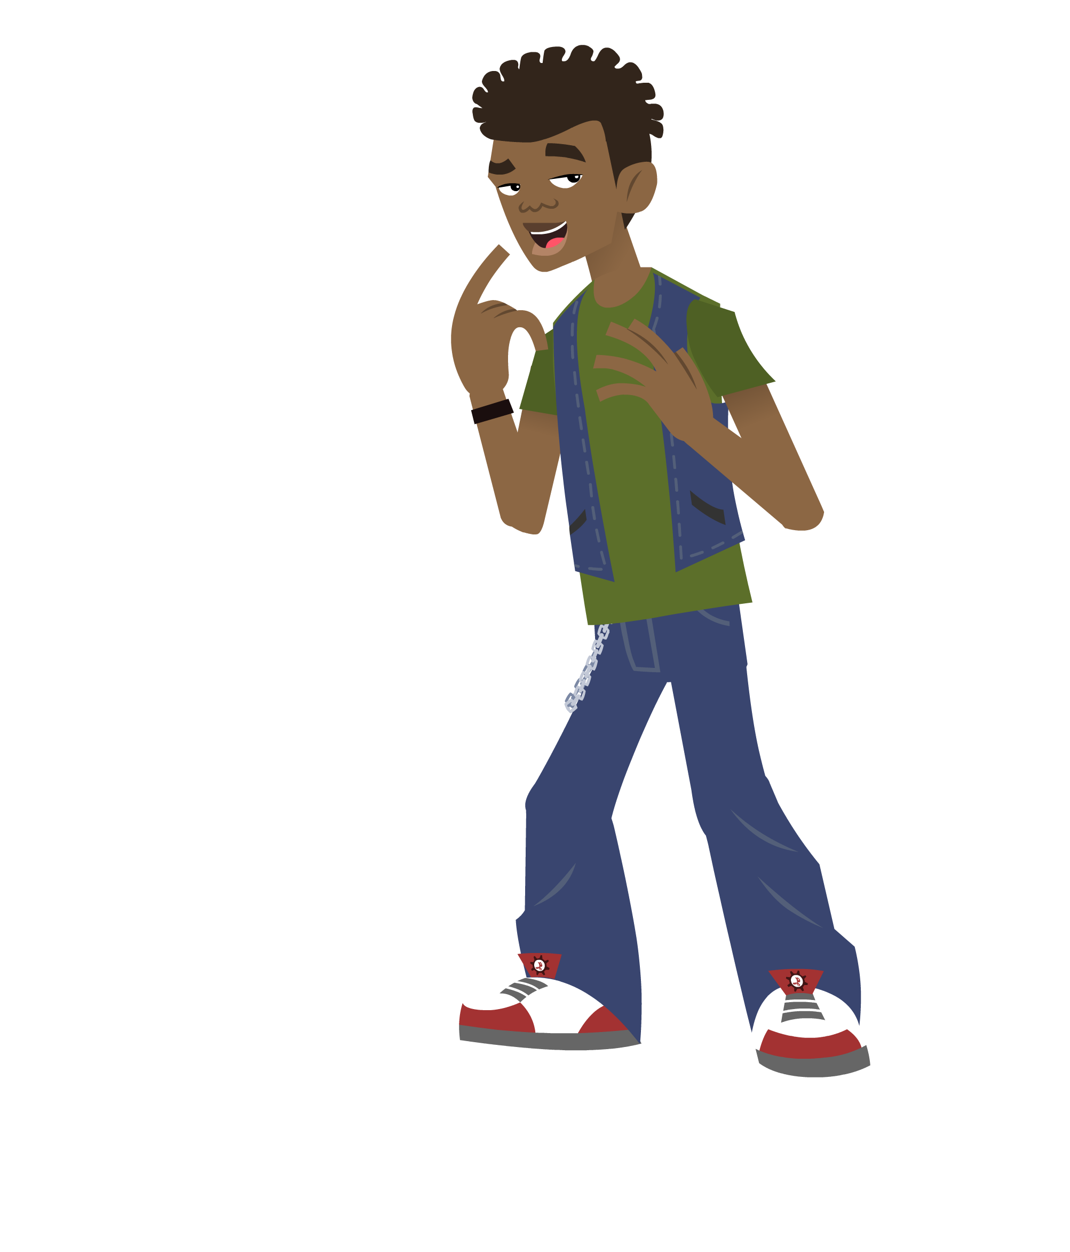
Do you remember the helpful tips for taking the i-Ready Diagnostic?
…

Slide 13
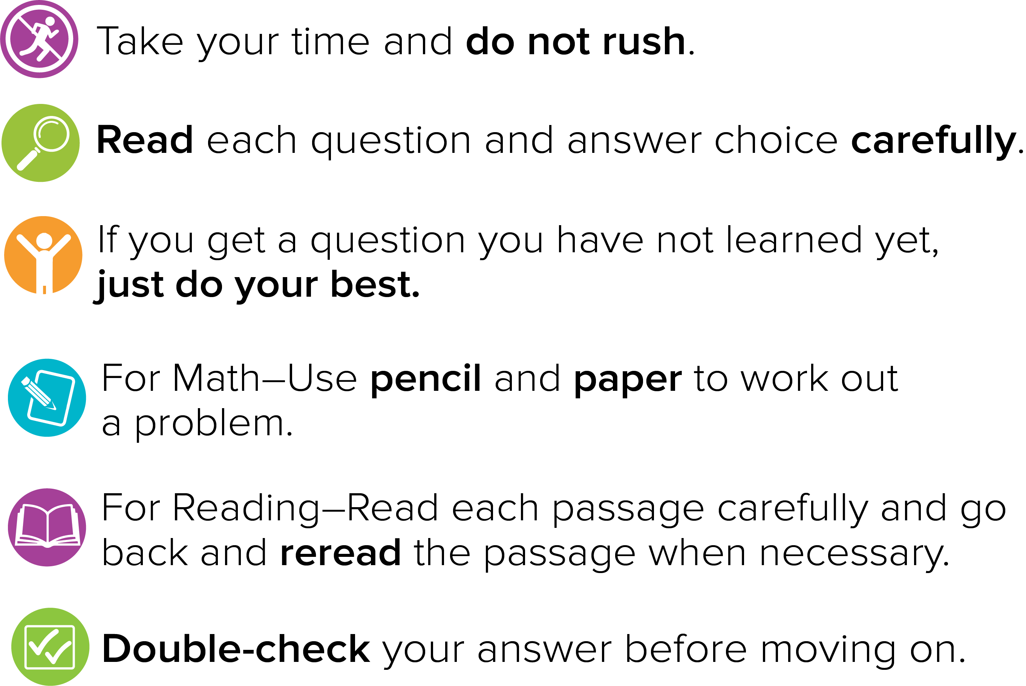
Some helpful tips:

Slide 14
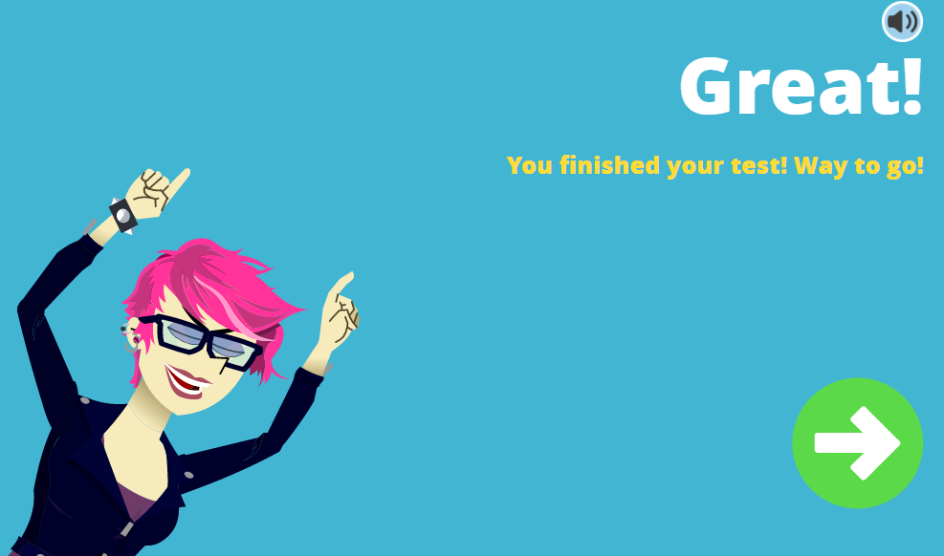
When you are done, you will see:

Slide 15
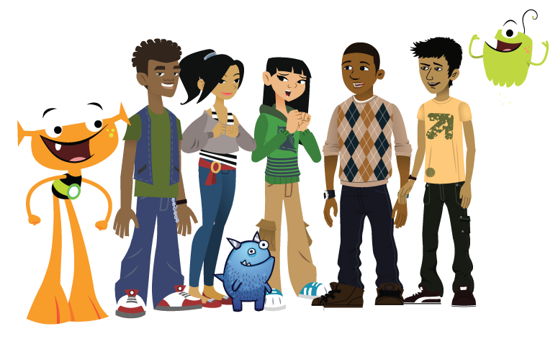
These assessments must be completed now.

Slide 16
For help logging in to i-Ready, please see next slides.

Slide 17
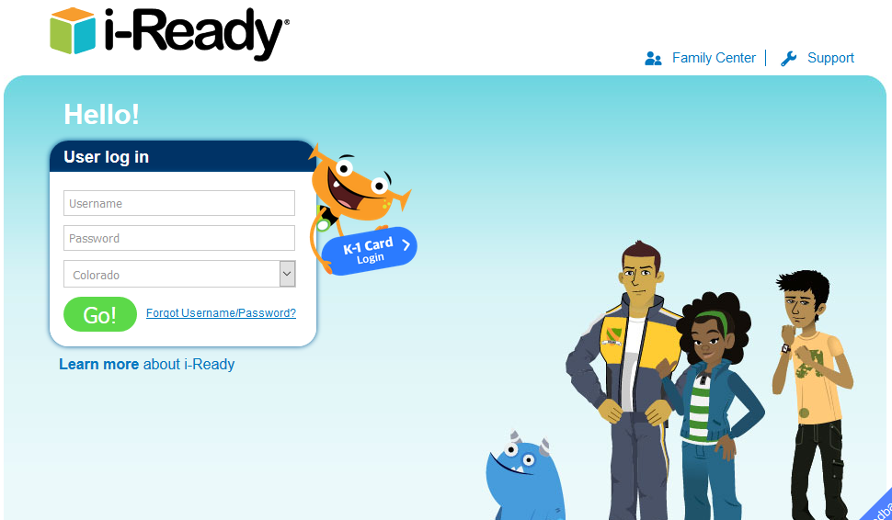
1. Go to https://login.i-ready.com/
2. Enter your username, password and state.
Username: Your Student ID Number.
Password: cprep
State: Colorado
Notes:
https://login.i-ready.com/
Tell families that you are going to walk them through the process. Then you will web push the link to iReady and they can get started during the session.
They will not complete the test during the session, they will start it. We will ask families to sign out after 20-25 minutes for the next grade level to log in

Slide 18
Student ID
1
To find your student’s ID if you don’t know it:
From the LC’s account, click on your name in the top right hand corner.
Click on My Info
Click on student name in new window
Click on School tab
Student ID is on the right
2
3
4
Notes:
https://login.i-ready.com/
Tell families that you are going to walk them through the process. Then you will web push the link to iReady and they can get started during the session.
They will not complete the test during the session, they will start it. We will ask families to sign out after 20-25 minutes for the next grade level to log in

Slide 19
Chrome issue with i-Ready
In i-Ready, some computers are having troubles running the scripts in Chrome. There’s a help document below from i-Ready. A permanent fix is on it’s way, but with no expected date.
Quick solution: if a student has problems seeing the content for their i-Ready test, switch to Explorer or Firefox browsers.
Semi-quick solution: they can change their settings in Chrome by doing this:

Slide 20
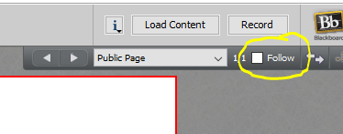
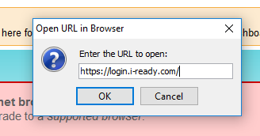
iReady Host Instructions
Upload iReady instructions PPT.
Uncheck the “follow” button at the top of the screen.
Push out the iReady site: https://login.i-ready.com/
Exit Ticket = All iReady tests complete.

Slide 21
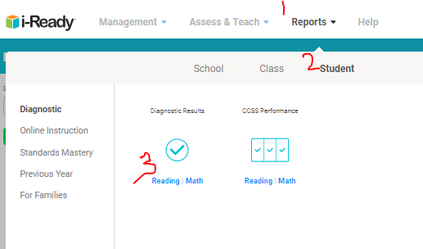
Checking iReady Completion

