Slide 1
SCHEDULER Meeting
4.6.23
Please remind me to hit the record button

Slide 2
Meeting Talking Points
What You Need to Know Now
Your Expected Tasks
How To Create a New Schedule
Steps to Reschedule in Testing Nirvana
Opt Out Expectations
Multiple Sites Protocol

Slide 3
What you need now
Know the Site Coordinators you are working with
Have the schedules for each of your sites
Access to Testing Nirvana
Knowledge about how to reschedule

Slide 4
Your Tasks
Coordinate a meeting time each day with your Site Coordinators at each site to obtain the list of absent students.
Call all absent families to plan a reschedule or get them the opt out information
As opt outs are updated in TN (every morning and possibly throughout the day) make sure you track the families.
Follow up with families who still haven’t responded or opted out until all at your site are accounted for – this will most likely go past the regular testing window. Plan to contact these families DAILY until they respond and use admin assistance as needed.

Slide 5
Schedule Changes
If you are scheduling during a make-up time at your site, you can do that in Testing Nirvana
If it isn’t working, reach out to me to correct it
If a family is wanting to change a site, DON’T fill out the survey. Just e-mail me and let me know and I will make the change

Slide 6
Creating a New Schedule
If your site shows an open room/testing time but Testing Nirvana is not allowing a reschedule, let me know and I can set it up for you
Ex. -

Slide 7
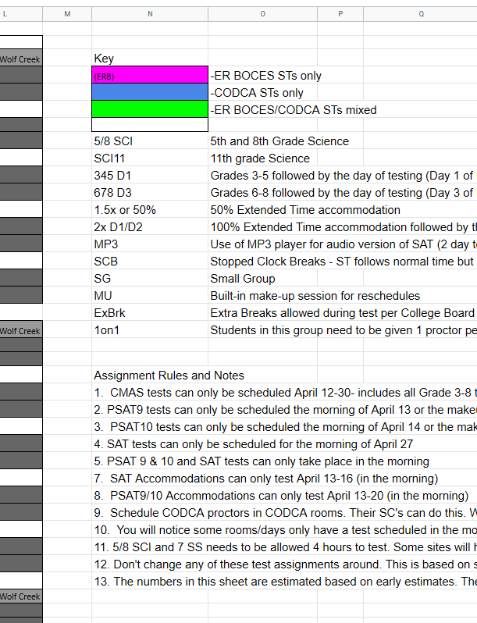
Know the Codes
Located to the right of the editable schedules in each tab.
Make sure you differentiate between 9th and 10th grade tests
i.e. – P 2xD1, P 2xD2 – is it 9th or 10th grade? Which date in the schedule corresponds with the correct grade?

Slide 8
Other Things to Know
PSAT9 can only be run April 13 AM or April 25 AM for the makeup
PSAT10 can only be run April 14 AM or April 26 AM for the makeup
PSAT9/10 accommodated tests (show on same line of students record in TN and will have something other that “PSAT9 or PSAT10”) can only be scheduled April 12-19.
SAT accommodated tests can only be scheduled April 12-14
All standard SAT tests can only be scheduled April 25 in the morning.

Slide 9
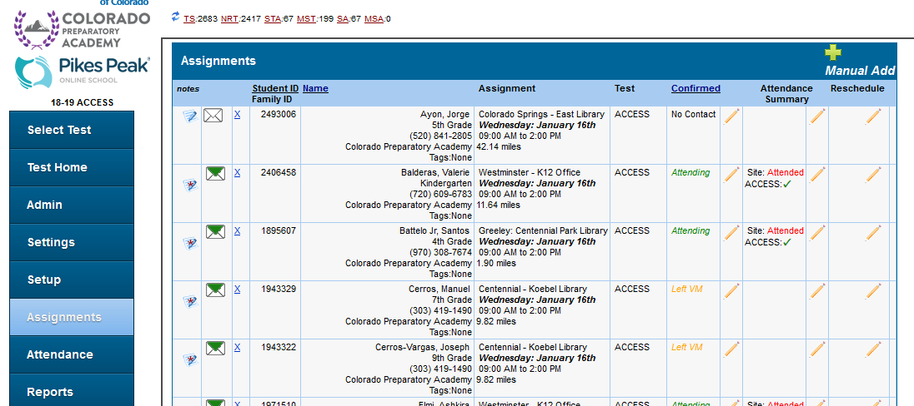
How To Reschedule-Step 1

Slide 10
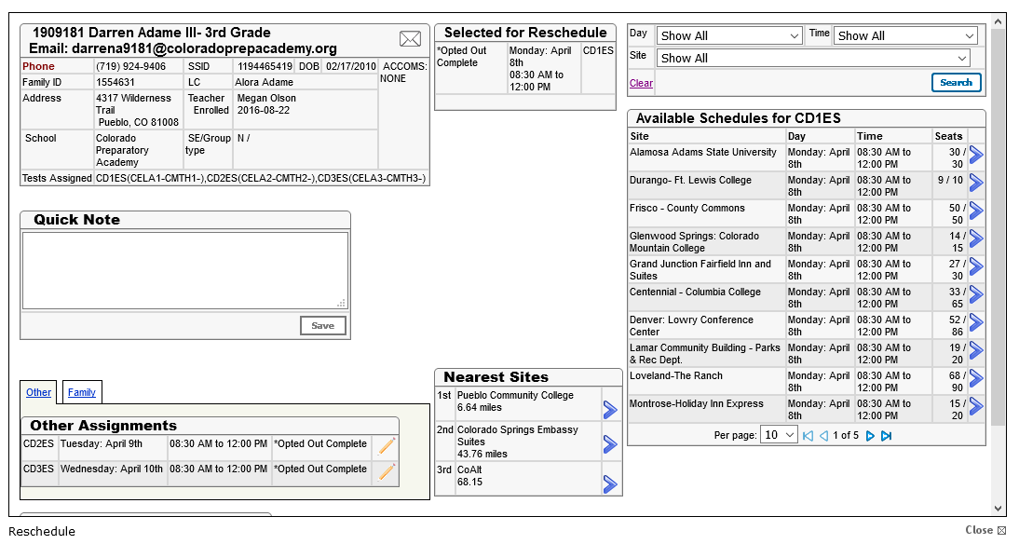
How To Reschedule-Step 2

Slide 11
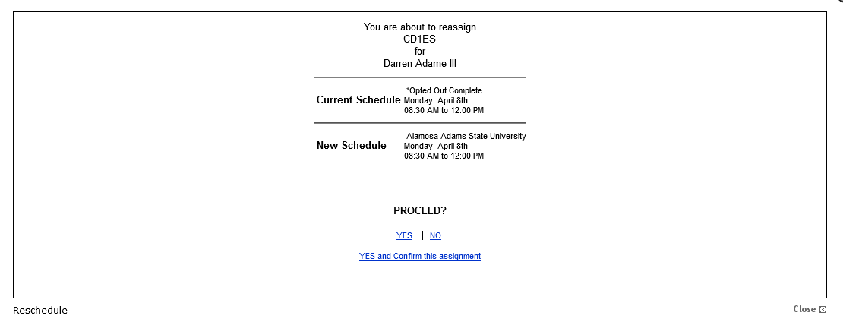
How To Reschedule-Step 3

Slide 12
How To Reschedule-Step 4

Slide 13
Opt-Out Expectations
Family decides to opt out – send them the link
Do you know how to find it?
Daily-please check to see if they are submitted
Will be placed in the Opt-Out On File testing room in TN when received by the office
Melissa is updating all opt-outs in TN but you will have viewing privileges this year.

Slide 14
Multiple Sites Protocol
Before testing begins, set up a contact schedule so your SC’s know when to report attendance to you
Make sure you are tracking all absentees/opt outs for all of your sites. You are the person who I will come to if we don’t see one come in.
PLEASE document all calls in TN with any updates so we can use those as we track opt outs after the window is closed.

Slide 15
Questions?
Thanks for attending!!! Reach out with any issues!

