Slide 1
STAR 360 Testing Plan

Slide 2
Agenda
Why
To gather data to meet student academic needs.
How
Testing directions
troubleshooting
When
During WOW
Where
Live testing sessions in BBC and Zoom with 30 students
2 teachers—1 test/1 trouble shoot
Make up sessions
Template for No-shows
Template to invite students

Slide 3
Before the Test
Send Test Invite Template
Working camera and mic needed
Assigned date and time
Set up and invite students in a BbC session

Slide 4
Testing Session
Teachers will use a Direction Template PP
Directions
Meet students in BbC
Zoom link “clickable” in the main room.
All students should also stay in BbC.
One teacher is active in BbC to troubleshoot issues with Zoom access.
After all students are in Zoom, BbC teacher moves all students to individual BORs.
Go over testing directions (in Zoom).
Give students log-in information.
Actively monitor completion.
If Zoom monitoring raises concerns, check student BOR audio.
Confirm reading and math completion before excusing the student individually.

Slide 5
After the Test Session
For absent students, send Missed Test Template
Invite to make-up session in BbC.

Slide 6
Templates

Slide 7
Test Invite Template
Dear Student-
I am excited to meet with you to learn all about your academic strengths. Our school is hosting online testing sessions for STAR 360 reading and math. This is a requirement, and you are assigned to meet with me DATE at TIME.
Each test will last about 20-30 minutes (40-60 minutes total). You will need to use your working camera and microphone so that teachers can actively monitor and ensure you try your best.
If your computer does not have a working camera, you can download an app to your camera-ready smart phone or tablet. Please use this link [Insert Link] to access the free Zoom app.
Please be sure to find your session link in your Class Connect schedule.
I look forward to “seeing” you soon!
Teacher Name

Slide 8
Missed Test Template
Dear Student-
I am excited to meet with you to learn all about your academic strengths, but I noticed that you missed your STAR 360 reading and math assigned test time. This is a requirement, and you are assigned make up these mandatory assessments on DATE at TIME.
Each test will last about 20-30 minutes (for a total of 40-60 minutes). You will need to use your working camera and microphone so that teachers can actively monitor and ensure you try your best.
If your computer does not have a working camera, you can download an app to your camera-ready smart phone or tablet. Please use this link [Insert Link] to access the free Zoom app.
Please be sure to find your session link in your Class Connect schedule.
It is important that you know that failure to complete these assessments during your make up session will result in repeating orientation week and a delay in the beginning of your coursework.
I look forward to “seeing” you soon!
Teacher Name

Slide 9
Test Direction Template

Slide 10
Welcome!

Slide 11
Accessing STAR 360
Directions for Logging into the STAR360 Assessments:
Go to the URL:
https://global-zone50.renaissance-go.com/welcomeportal/5438299
On the Welcome page, select I’m a Student.
Enter your username and password:
a. Username: |student.id| You can find this under My Info.
b. Password: Your first name (lowercase) + last 3 digits of your student number
Example: John Smith, student number 1234567
Username: 1234567
Password: john567
Click “Star Reading” on the homepage.
Select any one of the class options. Click “next”.
Click “Start”.
If you have been kicked out and cannot log in, please use the password “admin”.
Click “Star Math” on the homepage.
Select any one of the class options. Click “next”.
Click “Start”.
If you have been kicked out and cannot log in, please use the password “admin”.

Slide 12
Troubleshooting Tips
Issue #1 – Students can’t log into the site or when they do log in, the site doesn’t load right.
Make sure the students are using Chrome or Firefox
Make sure the cache is cleared
Make sure they have the most recent version downloaded

Slide 13
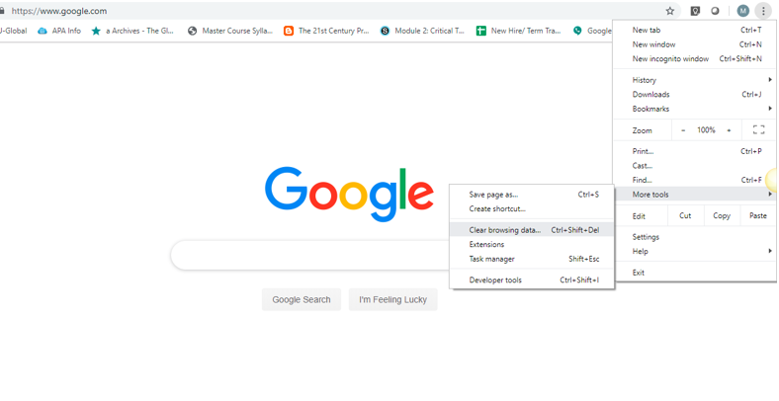
Clear Cache:
Select button in upper right corner
Select “More Tools”
Select “Clear Browsing Data”
Update to newest version:
Select button in upper right corner
Select “Update Google Chrome”
-if “Update Google Chrome” isn’t on the list, it has already been updated to the latest version
C
H
R
O
M
E

Slide 14
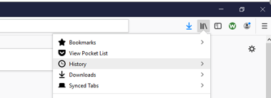
FIREFOX
Clear Cache:
Select history button in upper right corner
Select “History”
Select “Clear Recent History” in the pop-up

Slide 15
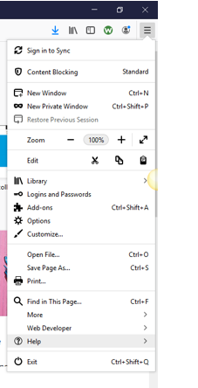
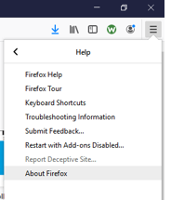
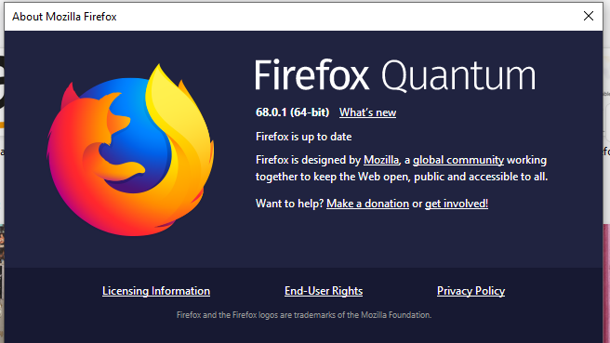
FIREFOX
Update to newest version:
Select button in upper right corner
Select “Help”
Select “About Firefox”
A box will pop up to let you know if the browser is up to date

Slide 16
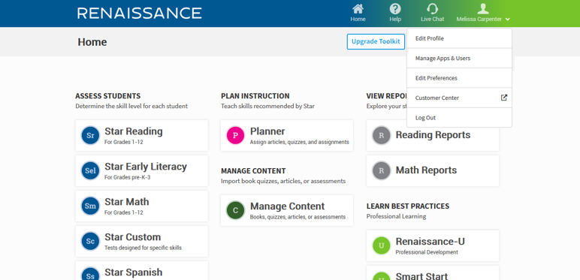
Issue #2 – Students log in too many times and get locked out
From home page, select your profile in the upper right corner and choose “Manage Apps & Users” from the dropdown

Slide 17
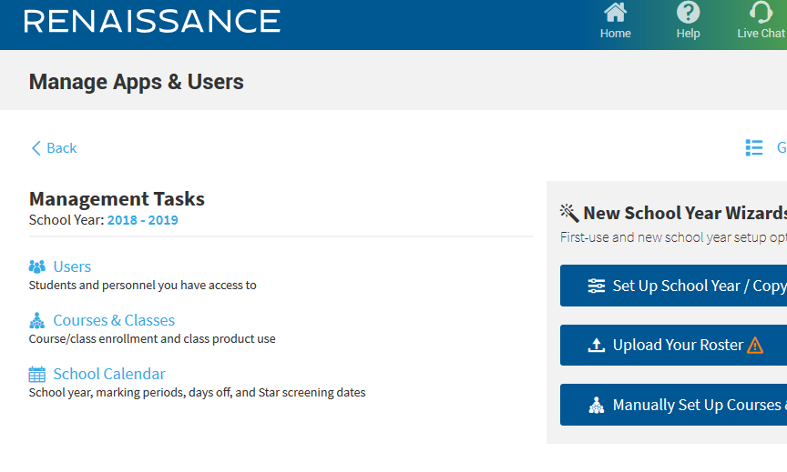
2. Select the “Users” tab

Slide 18
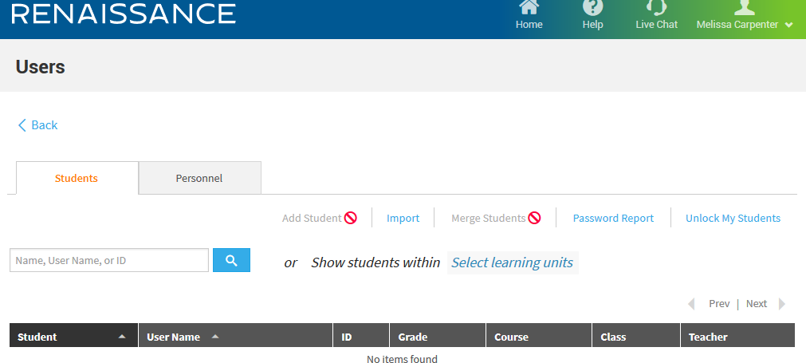
Select the “Unlock My Students” button
Choose the correct class or student and click “Unlock” at the top of the page

Slide 19
Issue #3 – Student Username and/or Password are not working
1. Follow the same directions
Click on profile
Select “Manage Apps & Users”
Select Users on next page
Select “Password Report”

Slide 20
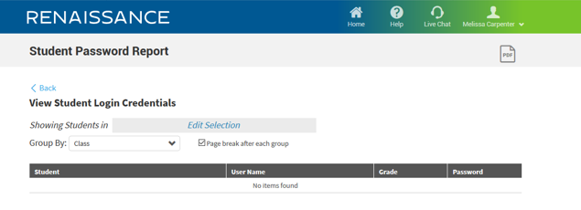
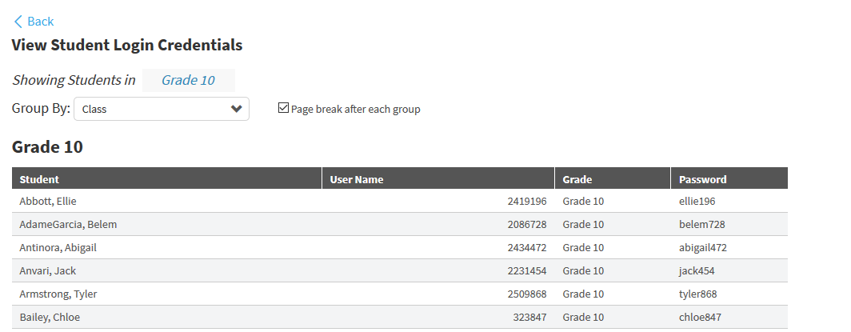
Select “Edit selection” and choose the school, teacher and grade level/course
The student list will show with usernames and passwords.
You are not able to change either the username or password for students

Slide 21
Issue #4 – Student is asked for a password when they log in
The password is “admin”.

