Slide 1
Colorado Assessment Accommodations for Students with Disabilities and English Learners 2022-2023

Slide 2
This session will be recorded

Slide 3
Official State Training

Slide 4
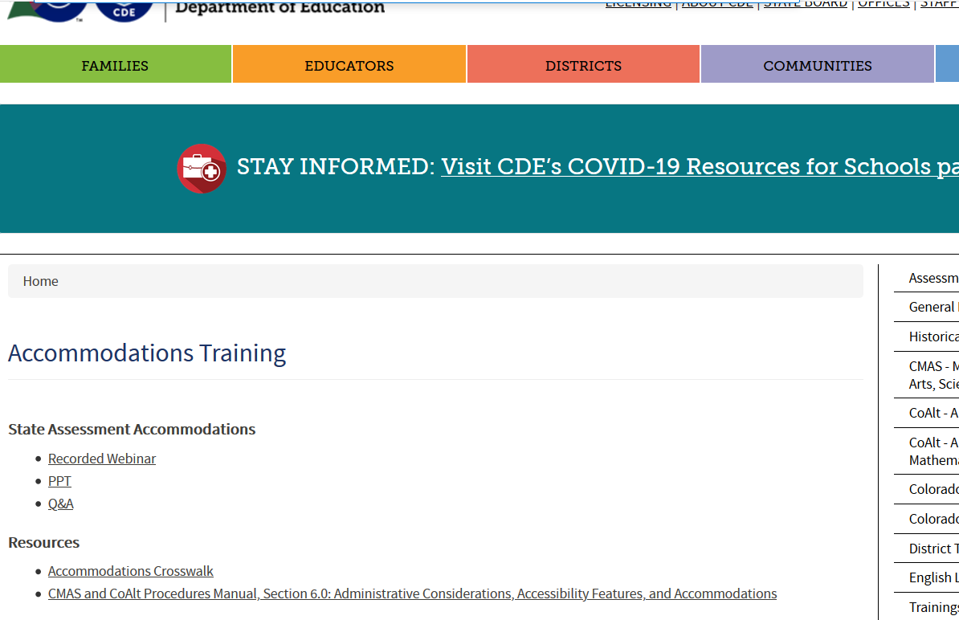
State Training Information
Invest an hour viewing the official recording of the accommodations training for more details
https://www.cde.state.co.us/assessment/training-accommodations - access the link from this PPT loaded in the Assessments website under Special Services

Slide 5
New Change This Year

Slide 6
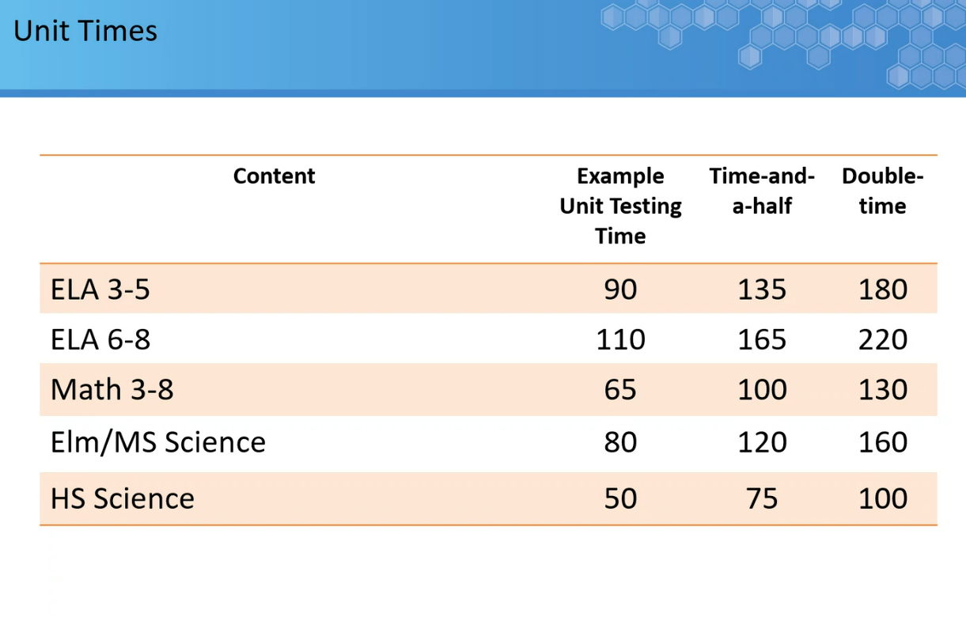
50% Extended Time for CMAS Science
Extended time is no longer built in. It must be requested through Enrich (by teachers) and added to Pearson (by Melissa).

Slide 7
Accommodations

Slide 8
State Assessments
ACCESS for ELLs - Grades K-12
Alternate ACCESS
Testing is in Jan/Feb
CMAS
Math – Grades 3-8
ELA/Literacy (CSLA) – Grades 3-8
Science – Grades 5, 8 & 11
Social Studies?? – Grades 4 or 7??
CoAlt – alternate to CMAS/PSAT/SAT
ELA & Math (DLM)
Science
CO PSAT 9/10 & SAT
PSAT 8/9 – 9th grade
PSAT 10 – 10th grade
SAT – 11th grade

Slide 9
Accommodation Flow for ACCESS/CMAS
All Students
May include students with active IEP/504/ELP (but not required)
Administration Considerations
Accessibility Features
Student must be an active NEP/LEP
Accommodations
Students must have an active IEP/504
Unique
Accoms

Slide 10
ACCESS for ELLs

Slide 11
ACCESS for ELLs Accommodations
Online
Paper
Kindergarten (paper)
Alternate ACCESS
4 Domains
Listening
Reading
Speaking
Writing
https://wida.wisc.edu/sites/default/files/resource/ACCESS-Accessibility-Accommodations-Supplement.pdf

Slide 12
ACCESS for ELLs
Accommodation | Online | Paper | Domain
Braille | N/A | X | L, R, W
Extended time of a domain over multiple days | X | X | L, R, S, W
Extended speaking test response time | X | X | S
Extended testing time within the school day | X | X | L, R, W
Human Reader | N/A | X | L, S, W
Interpreter signs test directions | X | X | L, R, S, W
Large Print | N/A | X | L, R, S, W
Manual control of item audio | X | N/A | L
Non-school setting for administration | X | X | L, R, S, W
Repeat item audio | X | X | L
Scribed response | X | X | L, R, W*
Student responds with recording device | X | X | W
Word processor or external device | Not allowed in Colorado | Not allowed in Colorado | L, R, W
*UAR Scribe submission is required for the Writing Domain

Slide 13
Accommodations for Kindergarten & Alternate ACCESS for ELLs
Accommodations Incorporated into the Assessment
Based upon the design of the assessment, some accommodations are built into the assessment and do not need to be coded as used
The following list of accommodations are incorporated in the assessment:
Extended speaking test response time
Human reader
Repeat human reader
Large print
Manual control of item audio (does not apply)
Repeat item audio (does not apply)

Slide 14
Unique Accommodation Requests (UARs) for ACCESS
A very limited number of students who meet specific criteria may qualify for unique accommodations
The requested UAR must be listed on the IEP/504 and tied to an instructional goal
Accommodations for ACCESS requiring CDE approval:
Scribe Accommodation for ACCESS in the Writing Domain
Speech-to-text requests are to be submitted as a “scribe” UAR
Scribe Accommodation for ACCESS uses a separate test form
Students who may qualify have an:
IEP/504 due to neurological disorder or physical disability; and
Identified disability connected to the inability to access this domain
All UAR paperwork for ACCESS is due to Melissa Carpenter by November 18th for all students
Use of unique accommodations without CDE approval may result in invalidation or score suppression

Slide 15
CMAS

Slide 16
CMAS Accommodations
Administrative Considerations
Accessibility Features
Accommodations for Students with Disabilities and English Learners
Presentation Accommodations
Response Accommodations
Timing & Scheduling Accommodations
Accommodations Unique to English Learners
Linguistic Accommodations

Slide 17
Administrative Considerations Available to ALL Students
Small group testing
Time of day within a school day
Separate or alternate location
Specified area or setting
Adaptive and specialized equipment or furniture
Frequent breaks (does not stop the clock)

Slide 18
Accessibility Features Available to ALL Students
Audio amplification
Color contrast
Answer eliminator
Frequent breaks (does not stop the clock)
General admin directions read aloud/repeated/ clarified
Highlight tool
Headphones/noise buffers
Line reader
Zoom-In/enlargement notepad
Pop up glossary
External spell check device
Text-to-speech
Time and a half for Science
Oral script (reader/signer)
Writing tools

Slide 19
Accessibility Features Available to ALL Students Text-to-Speech
Available in Math and Science
Assign TTS to a student who needs it and uses similar strategies during instruction
DO NOT assign to students “just in case”
Students will not benefit if they do not use TTS regularly during instruction and on class/district assessments
If students do not use this in their regular instruction, this feature can cause confusion and/or be a distraction, interfering with their access to the assessment
Students don’t use it…
Requires too much bandwidth
Creates unnecessary additional administrative burden

Slide 20
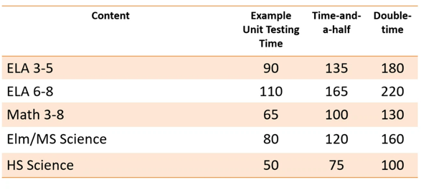
Unit Times

Slide 21
Unique Accommodations Requests

Slide 22
Unique Accommodations Available
Accommodations requiring a UAR
ACCESS
Scribe Accommodation for the Writing Domain on ACCESS will be available on a separate form (Speech-to-Text requests are to be submitted as “scribe”)
UARs for Scribe Accommodation for ACCESS are due November 18, 2022
ELA/Literacy
Scribe Accommodation for ELA/CSLA Constructed Response: Human Scribe
UARs for Scribe Accommodation for CMAS for ELA/CLSA Constructed Response are due December 2, 2022
Math
Calculator on non-calculator sections
UARs for Calculator on Non-Calculator Sections for CMAS are due December 2, 2022
CMAS UARs for students who arrive in the district after January or are newly placed on IEPs are due by February 15th

Slide 23
Unique Accommodation Requests (UARs)
A very limited number of students who meet specific criteria may qualify for unique accommodations
The requested UAR must be listed on the IEP/504 and tied to an instructional goal
These accommodations might impact the construct being measured. For that reason, additional documentation is required.
Recent data documenting need/use of the accommodation
For example: Scribe for ELA/CLSA Constructed Response:
Submit a sample of student’s handwriting without support
Submit a sample of student’s typing/keyboarding without support
Students with a neurological disorder or physical disability that significantly limits or prevents the student from writing or typing
Use of unique accommodations without CDE approval may result in invalidation or score suppression

Slide 24
Reminders
Data must be submitted with all UAR submissions for consideration
Do not send student IEPs with UAR submissions.
Math Charts and Counters are approved at the district level and do not come to CDE
Number lines are not an approved tool and cannot be used on the math assessment
Modifications are a misadministration and will result in an invalidation of scores.
If there is a significantly rare situation that needs to be taken into consideration, contact Arti Sachdeva at CDE

Slide 25
CO PSAT 9/10 SAT

Slide 26
CO PSAT and SAT
PSAT is administered to all* students in grades 9 and 10
SAT is administered to all* students in grade 11
PSAT/SAT accommodation requests are handled directly by the College Board through their SSD online system.
Accommodation requests submitted to College Board must include documentation of the student’s relevant disability, how the disability impacts the student’s ability to access the assessment, and how the accommodation being requested is appropriate to provide access to the student.
Students who tested using College Board approved accommodations last year continue to be approved for 2022 as long as there are no changes to the student’s primary disability or accommodations listed in the student’s IEP.
*Students who participate in CoAlt will take the DLM ELA & Math assessment instead of PSAT/SAT

Slide 27
CO PSAT and SAT
Colorado PSAT/SAT and CMAS constructs and administration modes are not identical. Available accommodations may vary across assessments.
Accommodation requests and administrations are handled at the school level
Schools must request PSAT and SAT accommodations for 9th grade students, newly enrolled students, and students with a newly identified disability or whose primary disability has been recently changed
College Board’s SSD Online system is already open to review existing and submit new accommodations requests. All accommodations requests must be submitted by January 31, 2023. Schools must have parent consent prior to sharing disability information with College Board as part of the accommodations request process.

Slide 28
College Board updates:
Certain accommodation requests may require additional documentation (ex. a request for a human reader instead of MP3 audio)
Assistive Technology Compatible (ATC) form is used for students who use assistive technology related to visual disabilities
Works with JAWS, NonVisual Desktop Access (NVDA), and ZoomText
MP3 audio forms are available if a student needs an audio only version
There are state allowed accommodations (SAAs) and College Board approved (college reportable) accommodations
Many SAA and CR accommodations are the same, however SAAs should be used for a very limited number of students
Cannot change from SAA to CR after the fact
SAA’s are not college reportable

Slide 29
Presentation Accommodations
Reader
Staff reads test to student
Individual (1:1) tester
Automatic 50% extended time and extra breaks on all sections
MP3 Audio
Audio version of the test downloaded the morning of the test
Automatic 100% extended time, extra breaks on all section
Additional time for section 2 (writing & language)

Slide 30
Test Timing To Consider
 | PSAT 9 (Add 10 min. for breaks) | PSAT 10 (Add 10 min. for breaks) | SAT (Add 15 min. for breaks) | SAT w/Essay (Add 32 min. for breaks/ admin tasks)
Standard | 2:25 | 2:45 | 3:15 | 3:50
50% ET | 3:38 | 4:09 | 4:30 | 5:45
100% ET | 4:50 | 5:30 | 6:00 | 7:40
** Students are required to sit out the entire time, even if they finish early!**

Slide 31
Wrap-Up and Final Points

Slide 32
Final Points
More is not necessarily better
Not all accommodations benefit all students
Extended time is often over assigned
Accommodations will not provide benefit if the student does not use them during instruction on a regular basis
Is the student using STT consistently and regularly for instruction and classroom assessment?
If an assessment accommodation (which by definition cannot violate the construct) is in the IEP and is an allowable accommodation, the student must be offered the accommodation

Slide 33
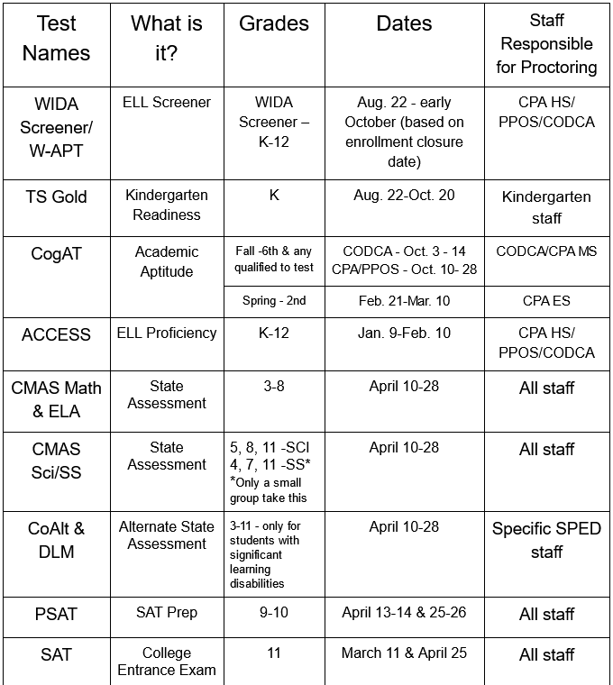
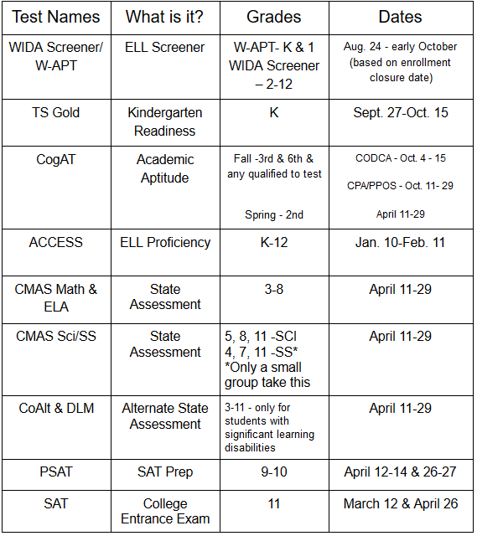
Testing Calendar
Found in General Testing & Blended tab in Assessments website
https://cok12assessments.weebly.com/
= requires accommodations

Slide 34
Accommodation Verification Process
Accommodations are submitted through Enrich
Two different pulls in first semester – Melissa will transfer them into Testing Nirvana
You will be given a week to verify accommodations – TIME SENSITIVE!!!
1-on-1 meetings can be set up to walk through any errors popping up or unique situations
For HS: College Board check will be completed to ensure Testing Nirvana matches with College Board

Slide 35
Important Dates
 | Round 1 – Initial submissions | Round 2- Later meetings/changes in 1st semester | Round 3- new enrollees and plan changes
Enrich data pulled and entered in TN by Melissa | Oct. 21 | Dec. 2 | Jan. 23
Accommodation Verification Window | Oct. 26-28 | Dec. 7-13 | Jan. 25-27
Final Cleanup | Oct. 31 - Nov. 1 | Dec. 14-15 | Jan 30-31
Sept. – Nov. – Update accommodations as you hold IEP meetings, High school staff should also submit to College Board
Nov. 18 – ACCESS UAR’s due to Melissa
Dec. 2 – All CMAS UAR’s due to Melissa
Feb. 15 – CMAS UAR’s for new enrollees due to Melissa
Jan. 31 – All new high school enrollees must have College Board accommodations submitted and new enrollee accommodations updated in College Board

Slide 36
Assessments Website Deep-Dive

Slide 37
College Board Submission Process Tasks for HS Staff
Get SSD access – form is in Assessments website – complete and email to Melissa
Look through all of your students in SSD. Figure out if accommodations need corrections or if a student is missing.
Submit information for new student or transfer from previous school
Check on approvals every few weeks to see if more documentation is needed

Slide 38
Thank You!

