Slide 1
ACCESS/screener Test Training
January 11, 2023
This session will be recorded.

Slide 2
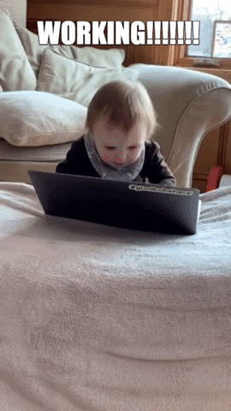
Do Now
Put your name in the chat

Slide 5
How does the test work?

Slide 7
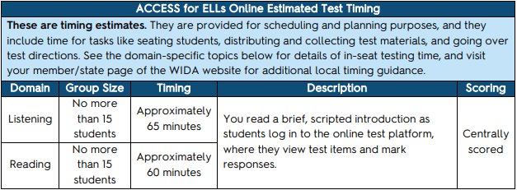
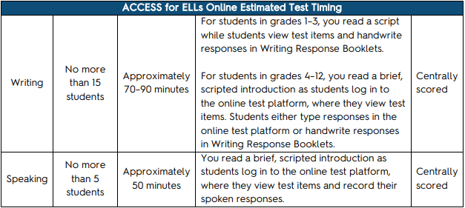

Slide 8
Kindergarten & Alternate

Slide 9
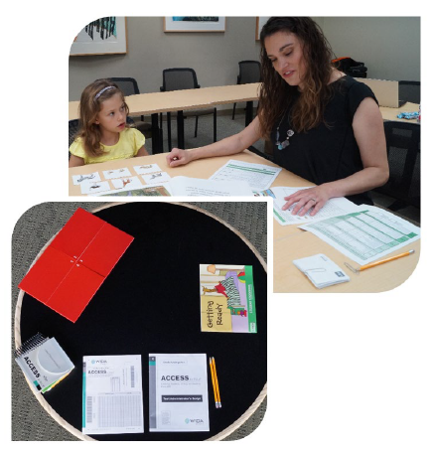
Kindergarten ACCESS
Kinder ACCESS usually takes about 45 minutes but no more than 60 minutes
Will be completed by volunteer ELL staff

Slide 12
Grades 1-3 Test
The first 3 sections are completed on the computer.
While the student is completing the Speaking test, please have the ELL staff member on site or call Matt Burns to check the tier assignment.
The tier options are either Tier Pre-A, Tier A, or Tier B/C.
Writing is completed in a paper book.
Make sure the student completes all sections in the booklet.
All completed test booklets must be shipped in the FedEx envelopes that day.

Slide 13
Grades 4-12
All of the sections are completed on the computer.
Please make sure that when students are speaking clearly and loud enough for the speaker to pick up their voices.
When students have completed the test makes sure that they are completely logged off of the test and that all sections are complete.

Slide 15
Required ACCESS Training
Training can be accessed in the WIDA Portal
Log into the Secure Portal
Select “Assessment Training”
Search for Online ACCESS for ELLs: Administration

Slide 16
Tech and Materials

Slide 17
Computer Set-Up
Helpful Hints:
As soon as you get to the site, set up the proctor computers and connect to the CradlePoint.
Call the phone # on the Laptop Screen if you are having issues connecting.
Plug in all headsets before starting any computers.
If a headset is unplugged for any reason, shut the computer down , plug in a headset and restart.
Continually check internet connection if there is an error message.
Open a browser page to ensure connection.
Materials in box
•1 proctor computer
•1 CradlePoint router
•5 student computers
•Mouse -5 per box
•Headsets with Mics-5 per box

Slide 18
Computer Set-Up (cont'd)
Use the Weebly website to find:
Proctor schedule
Includes site and location schedule(currently being updated), training status, and materials exchange plan
This training recording
Videos to demonstrate how to set up the proctor computer and student computers and get student signed in

Slide 19
Before the test

Slide 20
Confirmations
Proctors are responsible for ensuring the families at their site have confirmed attendance.
Calls should be made before testing if students are not confirmed.
The ELL staff will help by reaching out to their students as they are able but ultimately, it’s the proctor’s job to confirm and reschedule if needed.
IMPORTANT! If a family requests a SITE change, the form linked in the Assessments website MUST be filled out and please e-mail/zoom Matt with the change as well.
Failure to do so may prevent a student being sent home without testing if materials aren’t available.
Make sure to remind families to bring snacks/lunch to the site
We will be providing a snack box for our sites to pass out to students who didn't eat breakfast or didn't bring a lunch

Slide 21
Let’s Go To Testing Nirvana -Confirmations -Reschedules -Attendance
www.testingnirvana.com
Login: your k12.com e-mail address
Password: Whatever you chose post TN reset

Slide 22
Materials
Computer sets
Power Cords
Power Strips
Extension cords – larger sites
Headsets with Microphones – ear buds can be used if needed (included in computer box)
Paper Tests – K-3rd
All Test Scripts
Pencils and scratch paper
Testing Tickets
Zipper top plastic bags labeled for used pencils and test tickets/scratch paper
Color page and crayon packs
First Aid Kit
Do Not Disturb/No Cell Phone signs
Test Checklists
Sign in Sheets
Seating Charts
Snack Kit
Tape

Slide 23
During the test

Slide 24
Arrive at least 1 hour early (site depending) and set-up testing computers
Have families sign in as they arrive and collect all cell phones/wearable technology
After students are seated, complete the seating chart
Take Attendance in Testing Nirvana – one proctor should be calling all missing students to try to get them to the site or reschedule
Talk students through logging in and let them start
Students can work at their own pace
Once the 1st-3rd grade students complete the first 2 tests, let your assigned ELL staff member or Matt Burns know to check the correct Tier they need for Writing
Remind them to SPEAK UP for the Speaking portion
Actively proctor and monitor the test!
Establish a lunch time for the site (around 12) for all to take a break
Keep food/drinks away from computers and have them wash hands before testing again
Once a student finishes, the adult can be called to pick-up
Make sure the adult/parent/guardian signs the student out

Slide 26
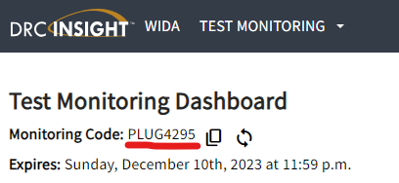

Slide 33
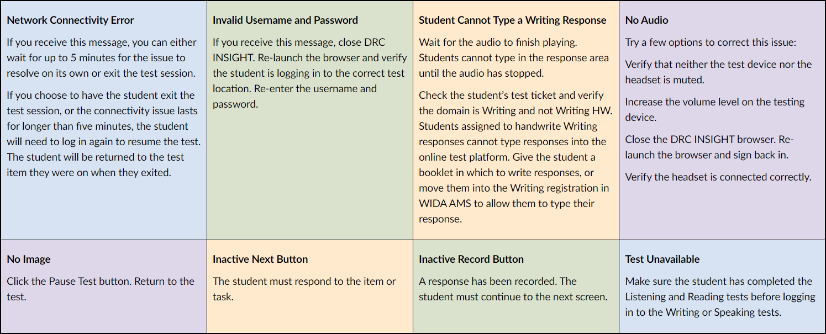
Common Tech Issues

Slide 34
After the test

Slide 35
NEATLY (please!) pack up the computers. Please make sure all pieces and parts are included and wrap cords/use rubber bands to contain them
Ship out or hand off to the next proctor based on the Materials Exchange plan (4th tab of Proctor Schedule) in the Assessments website
Matt will add the labels in the outer label pack behind the main shipping label

Slide 36
wIDA Screener

Slide 37
Who is this for?
All new enrollees with a language of other influence noted in the enrollment paperwork
Must be screened and if score isn’t high enough, will be scheduled to take ACCESS at a later date

Slide 38
Testing Format
Same as ACCESS
Kindergarten – Paper only with proctor script
Grades 1-3 – First 3 sections completed online with Writing as a paper test with proctor script
Grades 4-12 – Entire test taken online
Student can start test as soon as they arrive

Slide 39
Testing Format
Different from ACCESS
Kindergarten – Doesn’t use same materials, paper tests need to be scanned and emailed to Matt if no ELL teacher is on site
Grades 1-3 – paper writing test needs to be scanned and emailed to Matt if no ELL teacher is on site
Grades 4-12 – Uses 1 testing ticket rather than 4. Testing times are shorter

Slide 40
How this works
Screener STs will arrive around 12:30 – PLEASE call ASAP if they don’t show within 20 min.
All check-in tasks are the same as they are with ACCESS (sign in, collect phones, add to seating chart, etc.)
Give the student the Screener test
If testing a K-3rd grader, scan all pages of the written part of the test and email to Melissa Carpenter if no ELL staff member is on site.
If the student qualifies, the ELL teacher will reach out to the family to schedule them for ACCESS testing later.

Slide 41
Materials Included
Test Tickets – 1 per student – Grades 1-12
I will send a link to the online test ticket notebook each week in my proctor email to give access to any test tickets of students who enrolled after materials were sent out.
Kinder proctor script, Score sheets, Cue Booklets and Writing packet
Grades 1-3 Proctor Script and Writing Booklets
Screener Checklist to ensure all steps are completed

Slide 42
Wrap-Up
Add completed test packets/sheets and test tickets to used test ticket bag
Continue monitoring ACCESS testers
Mark Attendance in Testing Nirvana (under WIDA Screener – NOT ACCESS)

Slide 43
Assessments Website…Let’s Go!
https://cok12assessments.weebly.com/

Slide 44
Thanks for your attention!
Any Questions?

